Slide 1
LMI Data Synthesis Competition
Sheng Luo, Xiaochi (George) Li, Xinyu (Mandy) Zhang
The George Washington University
Notes:
Hi Everyone, my name is Mandy, and this is Sheng. We are graduate students in Data Science program. Today we are going to talk about using autoencoder for generating new data and building machine learning models.

Slide 2
Outline
Exploratory Data Analysis (EDA)
Data Preprocessing
Autoencoder Data Synthesis
Model building
Linear Regression
XGBoost
Notes:
During the hackathon, we did EDA, data preprocessing, autoencoder for data simulation, and we also used Linear regression and XgBoost for model building.

Slide 3
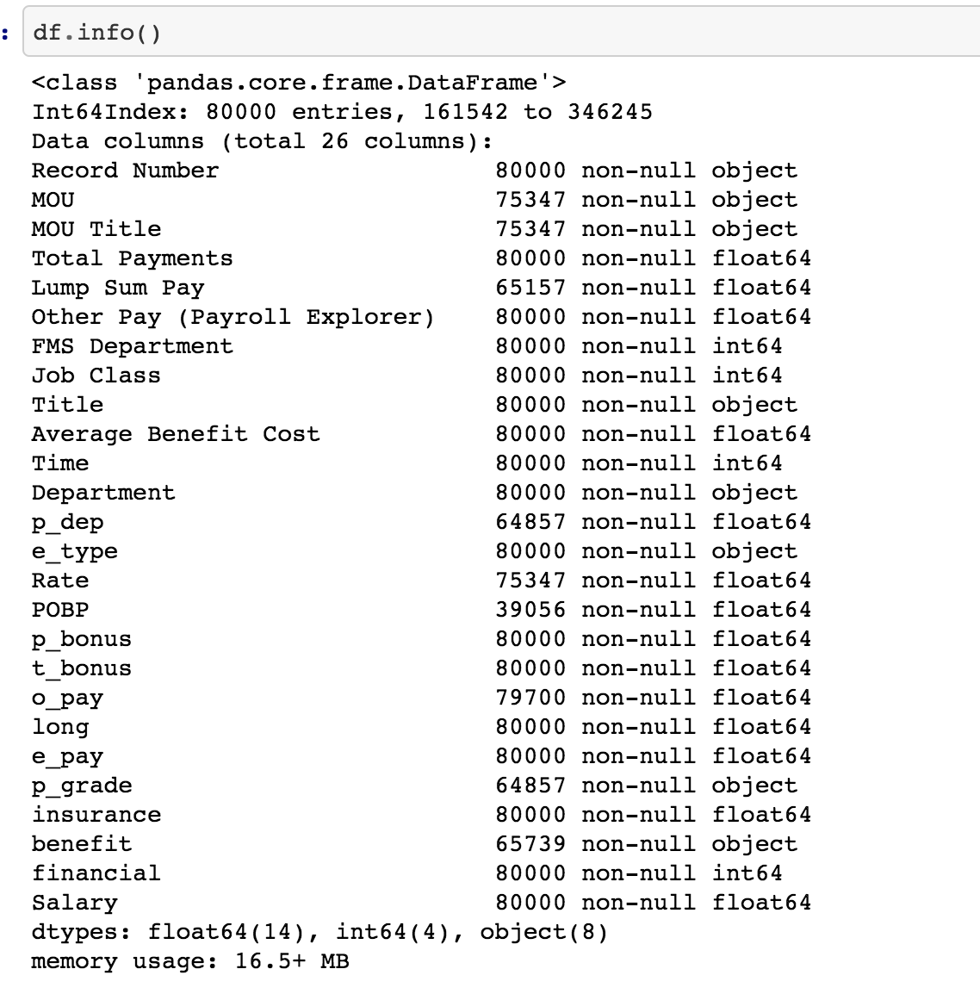
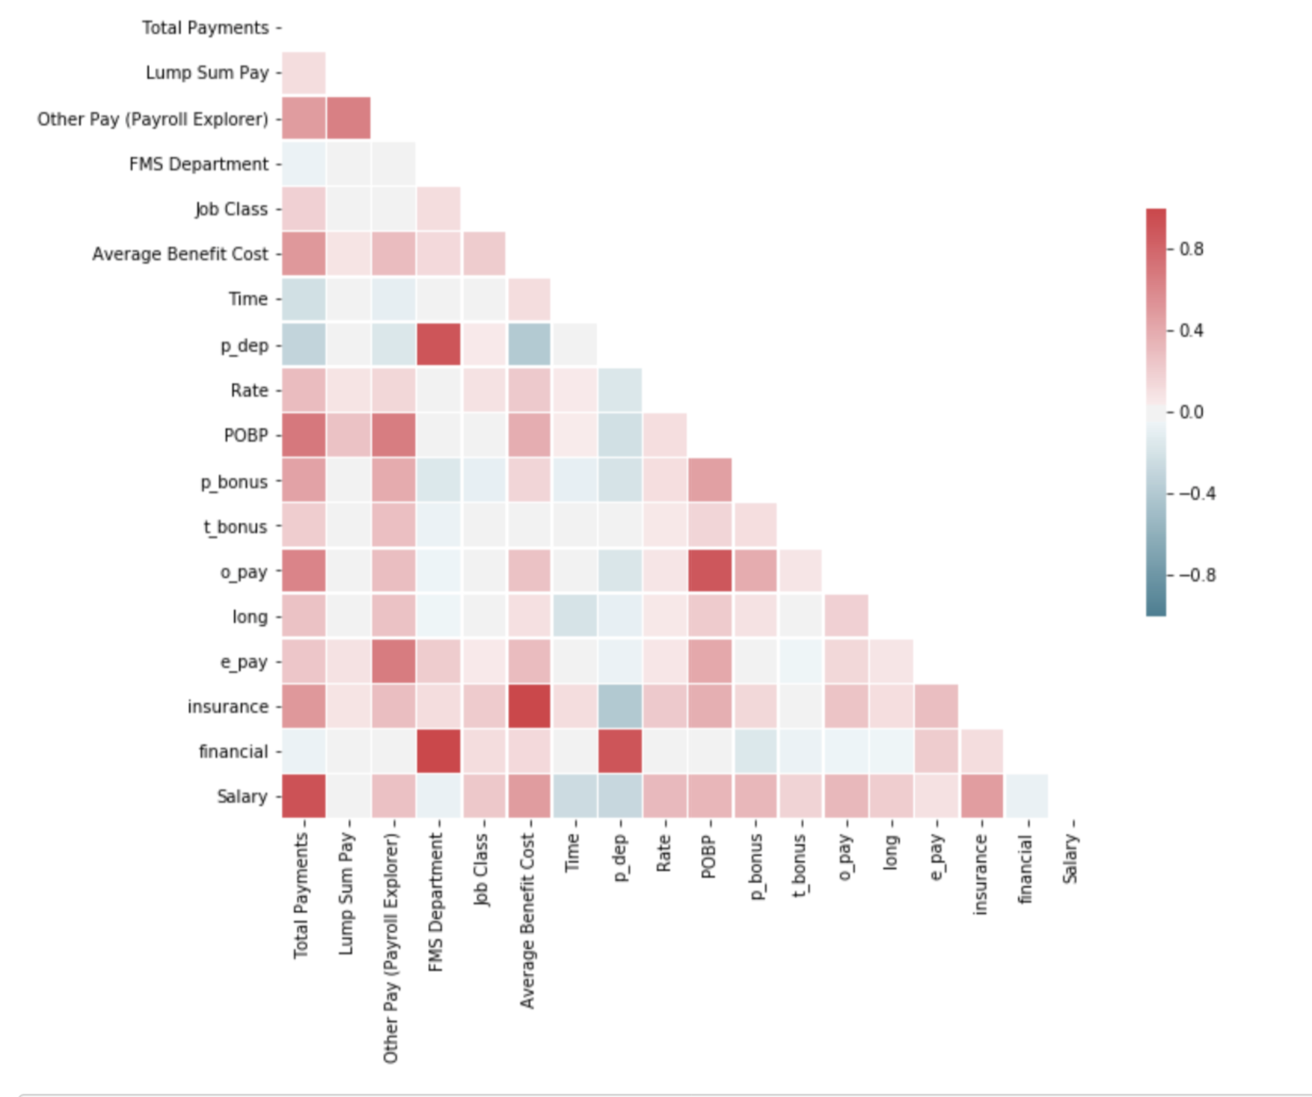
Exploratory Data Analysis
Notes:
As a data Scientist, the first important thing is to know better about the data. During EDA, we looked at the information about data structure, data type and so on. We also looked at the correlation of each two features.

Slide 4
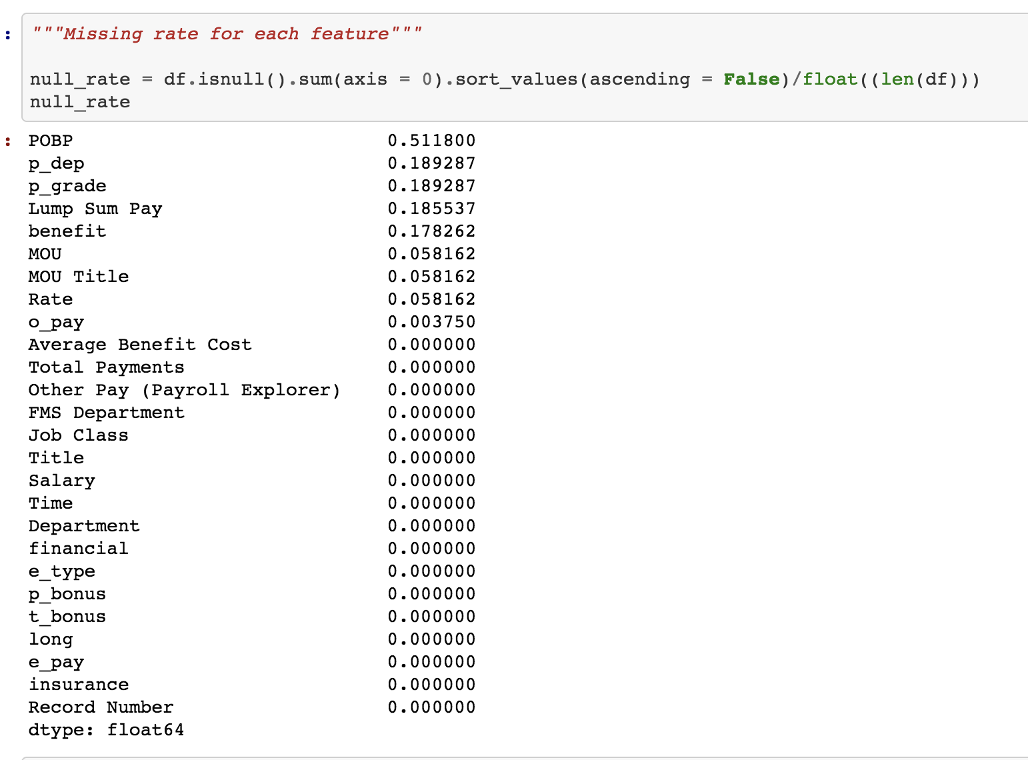
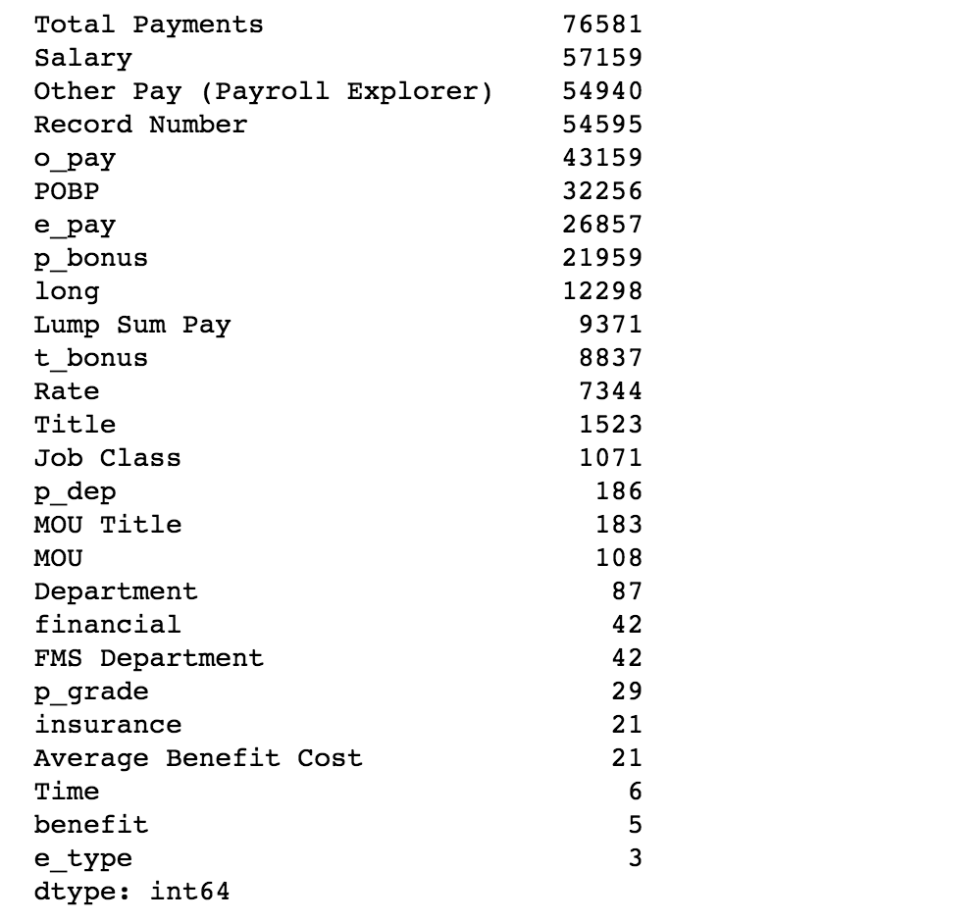
Missing rate for each feature/column
# of Unique for each feature
Notes:
In addition, we get the missing rate for each feature and count how many unique values in each column.

Slide 5
Data Preprocessing
Remove unnecessary features:
MOU
MOU Title
Title
Department
Record Number
POBP (>50% missing)
Simple data imputation:
P_dep: mean
Rate: mean
O_pay: median
Benefit: impute as “-1”
P_grade: impute as “-1”
Lum sum pay: impute as “0”
Save preprocessed data to pickle file
Notes:
Next is data preprocessing. First of all, we removed unnecessary features such as MOU, Title, and POBP which has more than 50% missing value. Secondly, we did simple data imputation. We used mean or median for numerical features, and imputed -1 or 0 for categorial features. Finally, we saved the data in pickle file for data simulation.

Slide 6
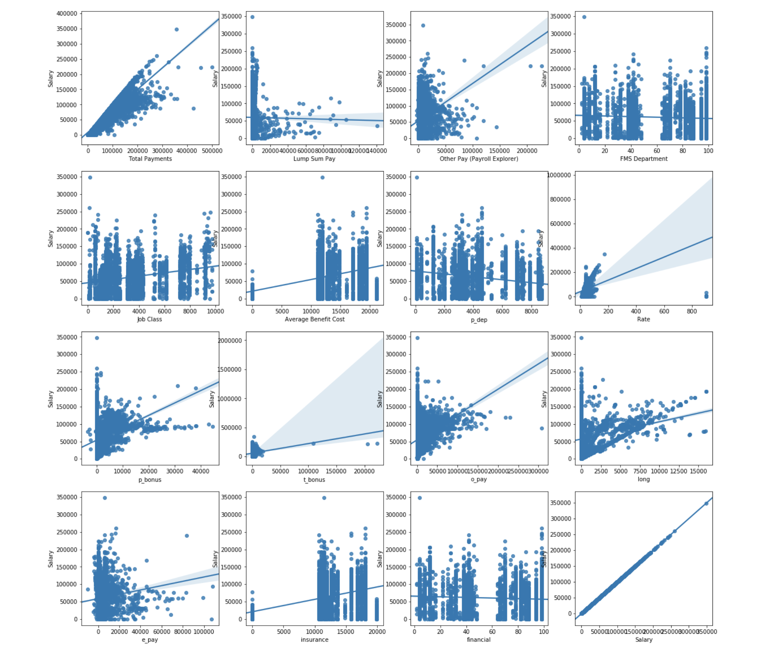
Scatterplots of numerical features after imputation
Notes:
Here is the scatterplots of numerical features after imputation. From this plot, we know the distribution of each numerical feature.

Slide 7
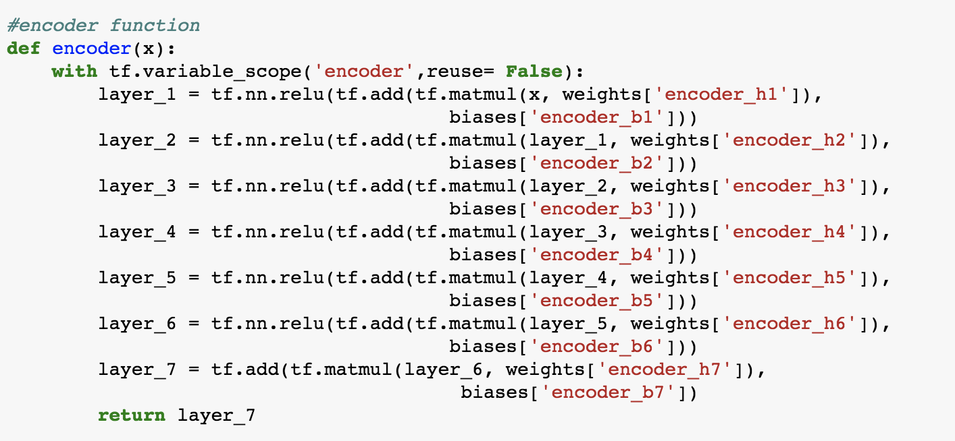
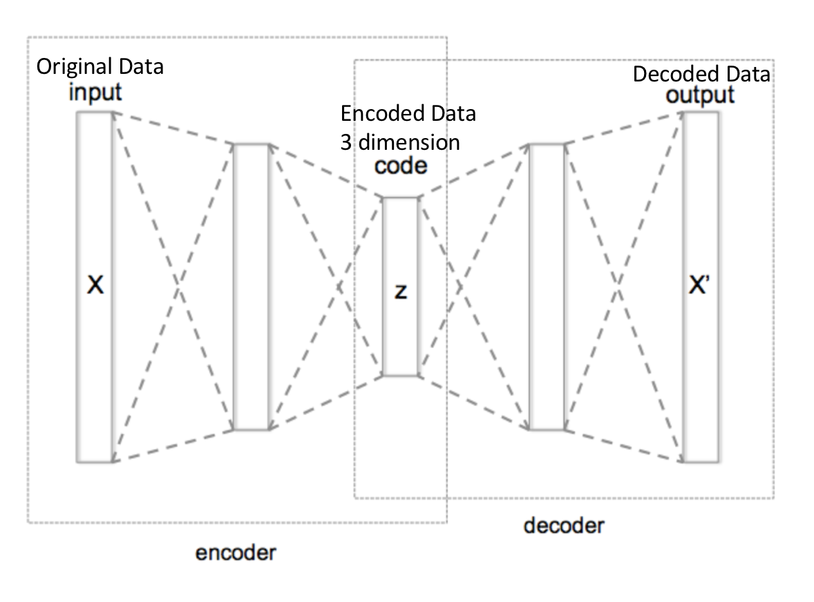
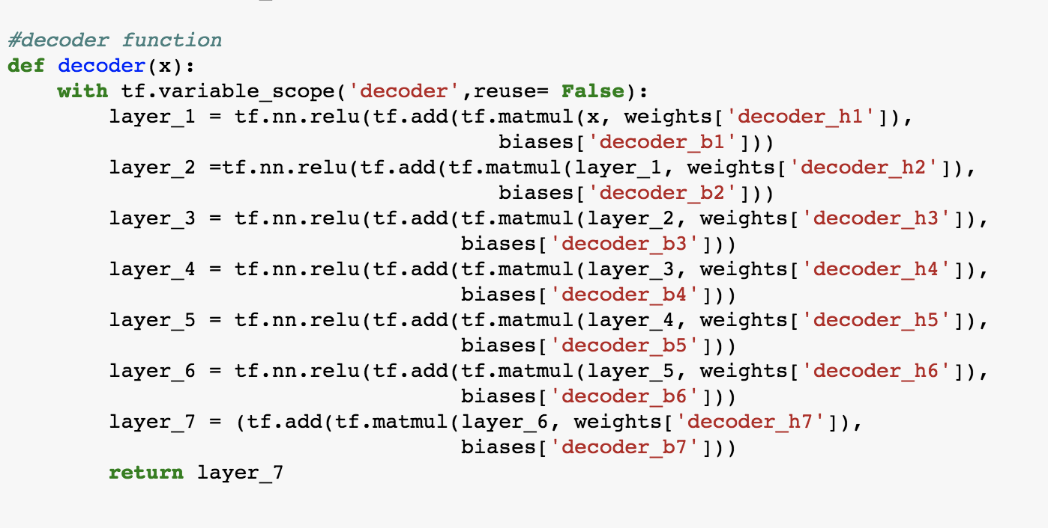
Data synthesis: Autoencoder!
Encoder: 7 layers of Neural Network
Decoder: 7 layers of Neural Network
Notes:
In our project, We use autoencoder to synthesize new data.
Autoencoder is one kind of neural network that has two different parts, encoder, and decoder. We use encoder to compress the data into low dimension, and use decoder to decompress the encoded data into the same dimension as the original data. And we want the result to be as similar as the input as possible.
Our autoencoder has 14 layers, 7 for encoder and 7 for decoder, we encode the data into 3 dimensions. After training the model, we generate a group of 3-dimensional data points as the input of our decoder, then we can get the synthesized data after decoding.
Unlike the normal autoencoder, our output has one more feature then the input which is the target column Salary. The reason is that we also want the autoencoder to figure out the relation between salary and the other features in the training process.

Slide 8
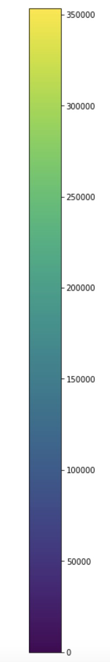
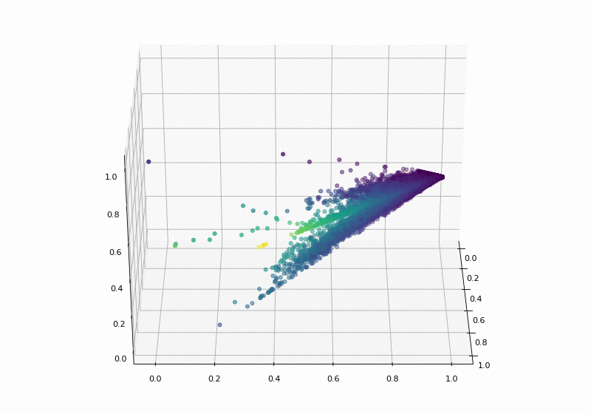
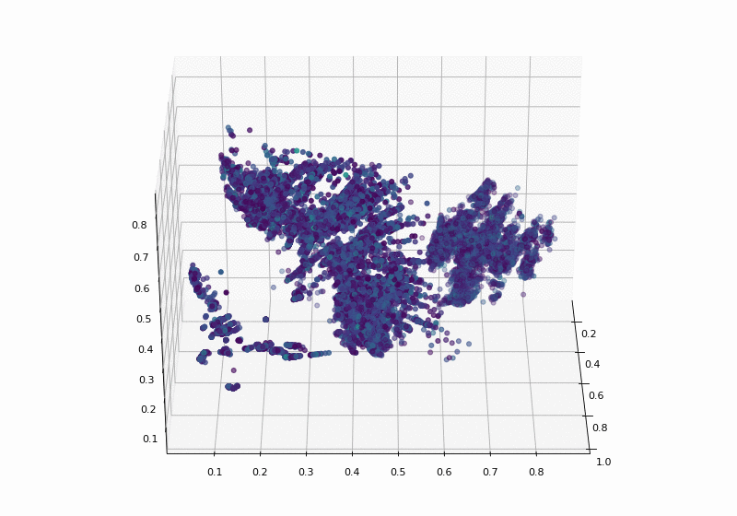
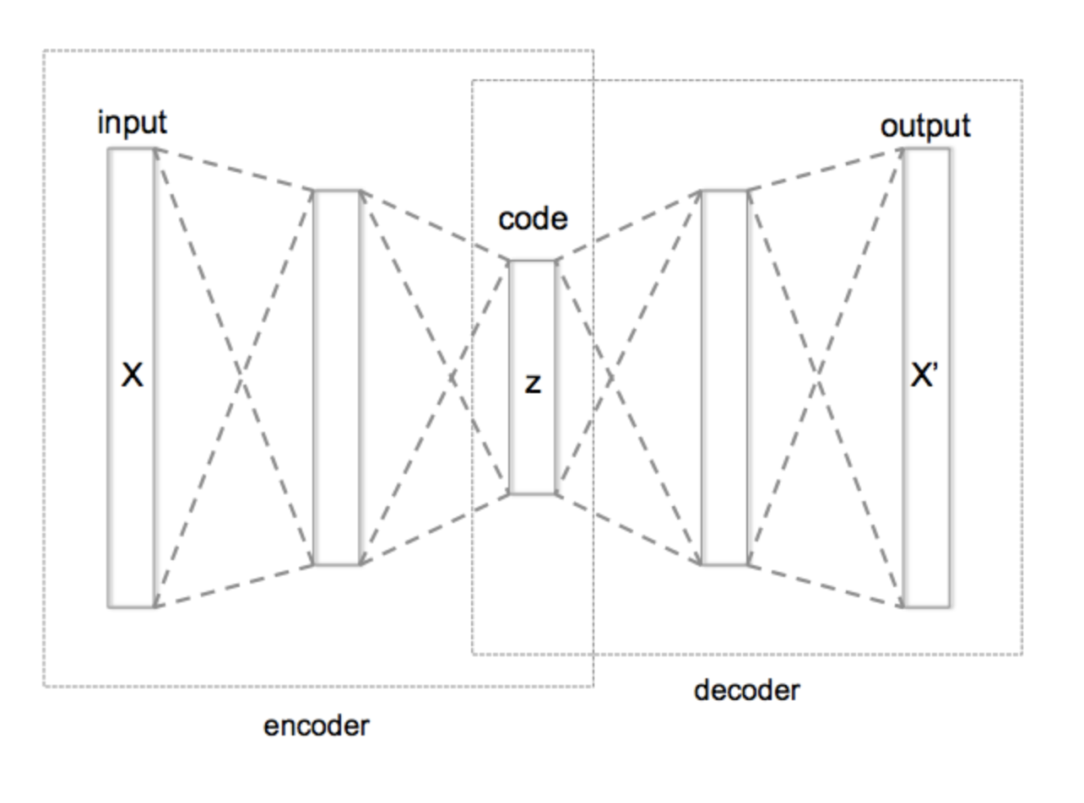
Training Autoencoder
Encoded the data into 3 dimensions
Original Data
Decoded Data
Encoded Data
3 dimension
Standardized: None
Activation: RELU
Standardized: MinMax Scaler
Activation: Sigmoid
Salary
The color of the points reflects the value of Salary: the darker, the lower salary; the brighter, the higher salary.
From the left figure, we can see some kind of linear relationship between the data points and salary, although it can't be explained by regular linear pattern.
From the right figure, because the sigmoid function introduces non-linear relationship into our model, we can’t see apparent linear pattern in it.
Notes:
We used TensorFlow to create autoencoder to synthesize new data as well as predict salary.
At first we designed two autoencoders with different structure. For the first one we used the ReLU as the activation function and didn’t standardize the input. For the second one, we used sigmoid as the activation function and Min Max Scaler to standardize the input.
These 2 animations are the visualization of the encoding result of 2 autoencoders.
The color of the points reflects the value of Salary: the darker, the lower salary; the brighter, the higher salary. From the left figure, …, from the right figure..
Well apparently the first figure conveys more information than the second one, however, the performance of the second model is much better. So we chose the second one as our model.

Slide 9
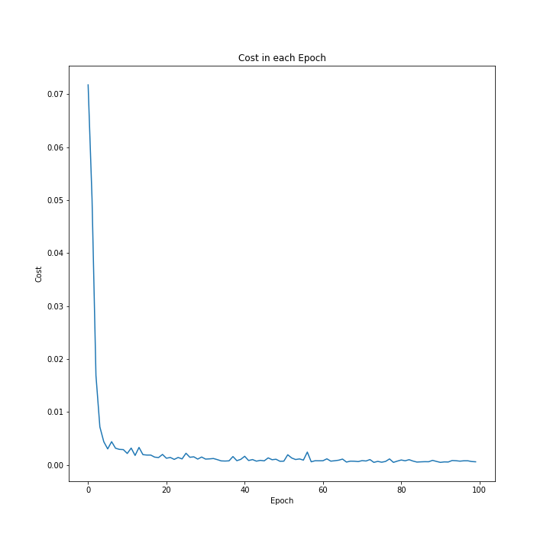
Evaluate the Autoencoder performance
Notes:
The line plot shows the cost of our second model, it does perform pretty well. The cost is very small and it converges to zero.

Slide 10
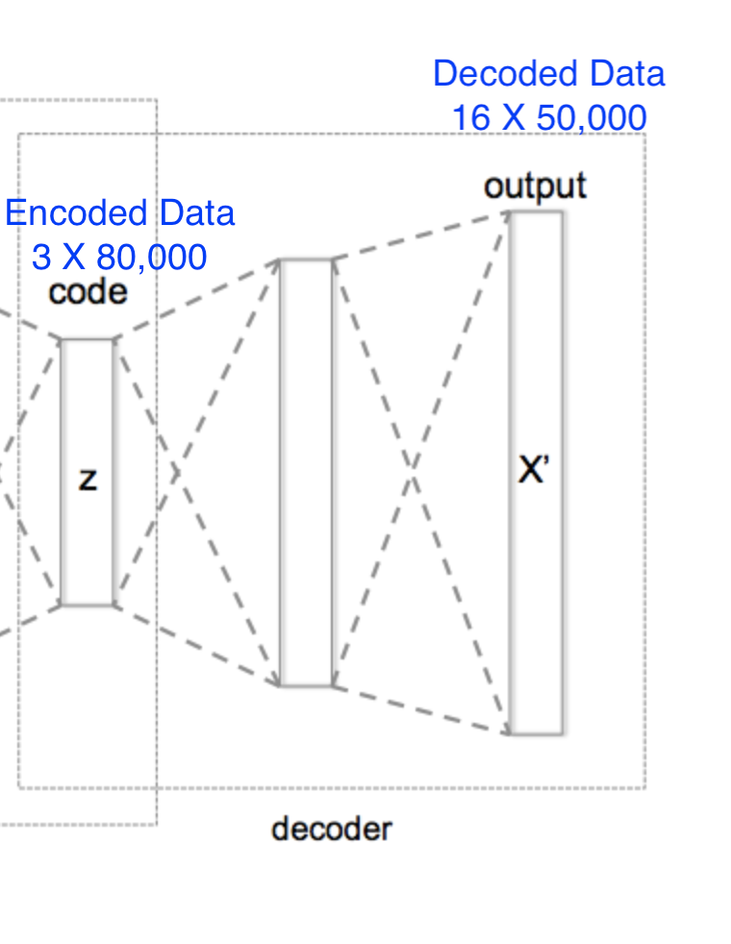
Use Decoder to synthesize new data
Although we can choose a random three-dimensional point as the input of the decoder, we still hope our random sample has a similar distribution as the original data.
We finally worked out a way to generate samples with the same distribution of given data.
Randomly pick up a point from the encoded data
Generate 3 random values from a normal distribution and add the values to each dimension of the point respectively.
We set a large standard deviation of the normal distribution if we want a very different sample. Otherwise, we can just set a small standard deviation.
Notes:
After we finish the training, we start to synthesize new data by the decoder. Although we can randomly generate the three-dimensional data points as the input of the decoder, we still want our random sample has a similar distribution as the original encoded data.
We tried to find an existing method to generate new data based on the distribution of current data from google, but we didn't find any related resources.
So we finally worked out a simple way to do so.
…
Choose 3 random values from a normal distribution and add the values to each dimension of the point respectively. The new data point will be one of our new sample. We can generate as many sample as we want by repeating these 2 steps.

Slide 11
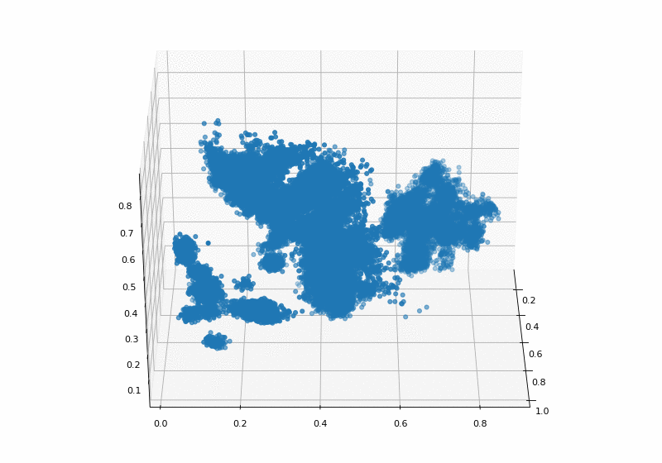
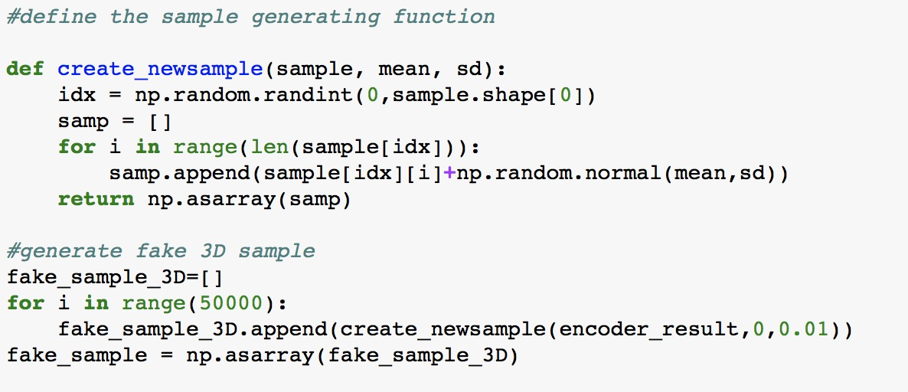
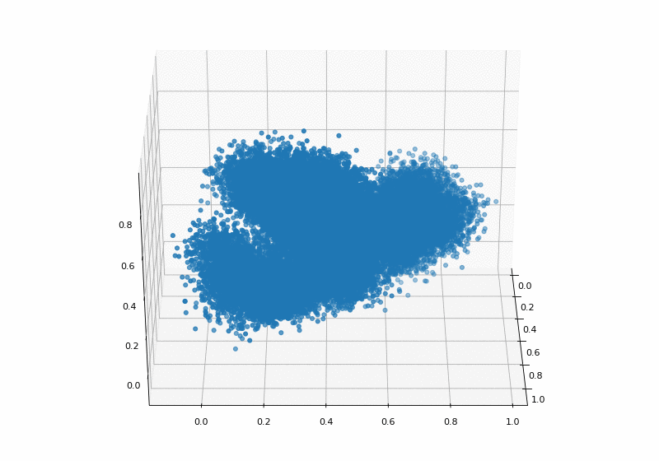
Use Decoder to synthesize new data
Encoded data
Synthesized Input
Sample
SD = 0.01
MEAN = 0
Synthesized Input
Sample
SD = 0.05
MEAN = 0
Notes:
Here is the code of the sample generating function.
On the right, the top figure is the visualization of the original encoded data. We saw it in the previous page.
The lower 2 figures are the visualizations of 2 groups of synthesized input samples, which were generated by 2 different standard deviations, 0.01 and 0.05. We can see they retain the similar distribution as the original encoded dataset. That’s actually what we want.
As for us, we chose the middle one as the input of our decoder. And finally, we got our synthesized data after decoding.

Slide 12
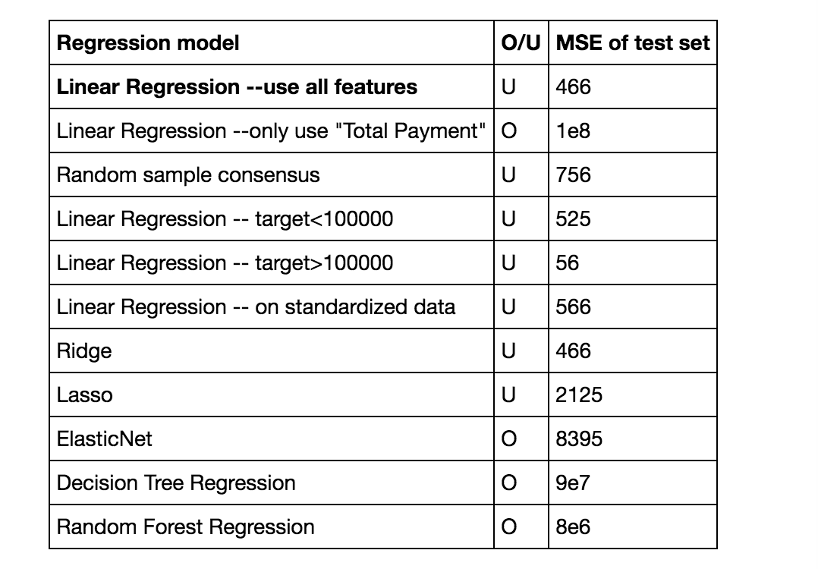
Model Building: Linear regression
Summary for all the models: O is Overfitting, U is Underfitting
Notes:
Finally is model building section. First we created a linear regression model. Like classification case, we use accuracy rate for evaluation of model performance. Here in predicting Salary which is regression model, we use MSE as a measure of performance.
Looking at the tables, there are many models such as Ridge, Lasso, or random Forest regression. But based on the MSE, we finally choose the linear regression.

Slide 13
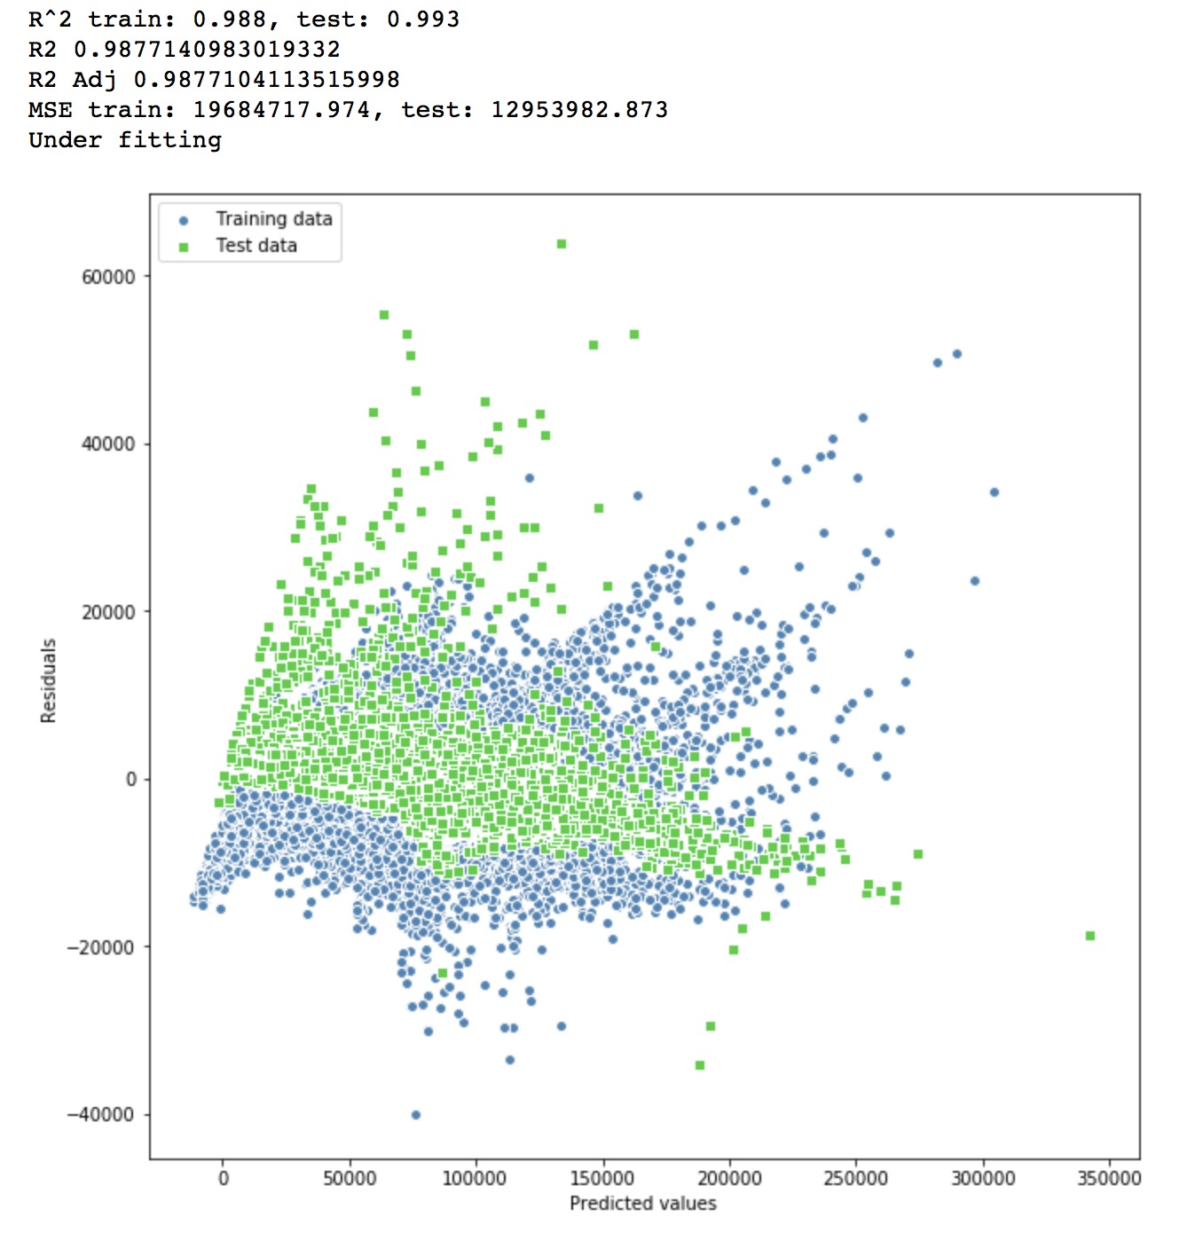
Linear Regression
One-hot-encoding for categorical features
Split train and validation into 0.7:0.3
Standardization into one scale
Build linear regression via Sklearn
Evaluate model performance:
Compute R^2 on train and test
R^2 Adjusted
MSE on train and test
Saved model into pickle
Notes:
When we were building the model, we did one-hot-encoding for categorical features; we split train and validation set into 7 to 3. then we standardized numerical features into one scale. Finally we build linear regression by Sikit Learn and computed R Square, MSE to evaluate the model.
The plot on the left is a residual plot. Residual plot is a commonly used graphical tool for diagnosing regression models.
The X axis is predicted values. The Y axis is residuals, which we simply subtract the true target variables from our predicted responses.
In case of a perfect prediction, the residuals would be exactly zero, which is a horizontal line at 0 on Y-axis. However, in realistic and practical applications, it’s not possible to see the perfect prediction. So we would expect that the errors are randomly distributed and the residuals should be randomly scattered around the centerline.
In this case, we find that the pattern of points is not randomly distributed and didn’t scattered around the centerline. This means that our model is less able to capture some explanatory information, which has leaked into the residuals. Therefore, more complicated model would be better.

Slide 14
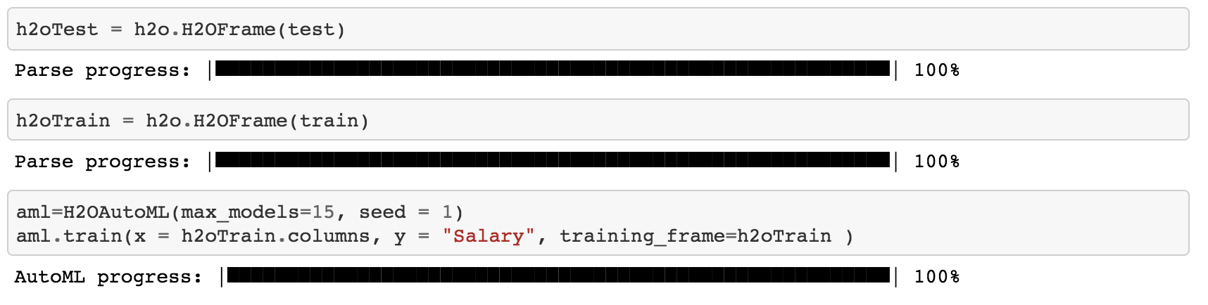
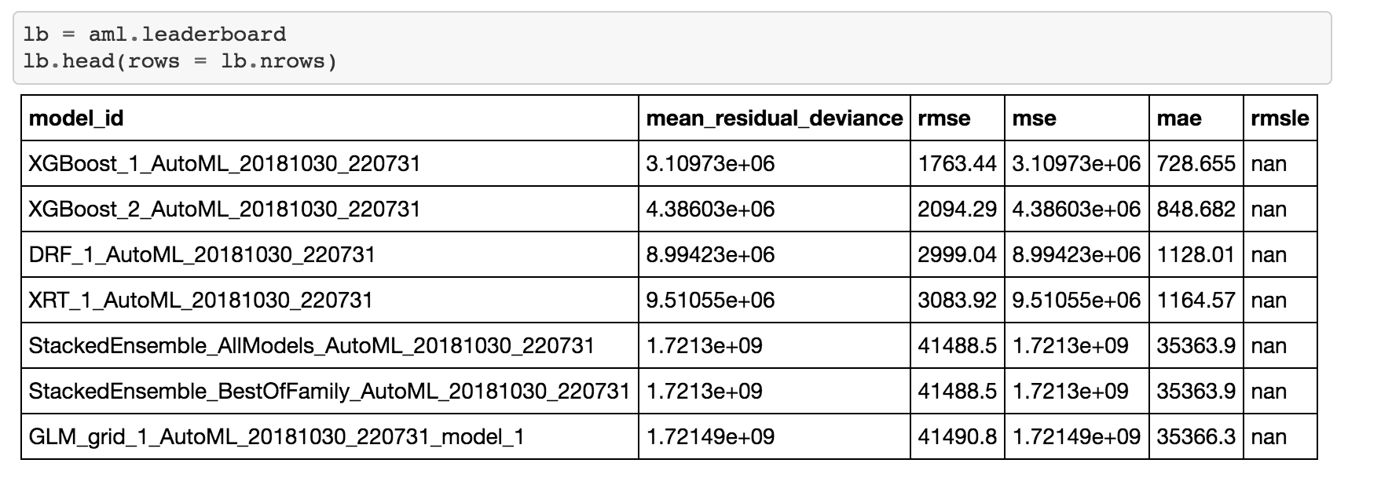
Model Building: XgBoost by H2O
The AutoML object includes a “leaderboard” of models that were trained in the process, including the 5-fold cross-validated model performance (by default).
The models are ranked by a default metric based on the problem type (the second column of the leaderboard). In binary classification problems, that metric is AUC, and in multiclass classification problems, the metric is mean per-class error. In regression problems, the default sort metric is deviance.
Notes:
So the more complicated model is XgBoost by H2O. H2O’s AutoML can be used for automating the machine learning workflow, which includes automatic training and tuning of many models.
The AutoML object includes a “leaderboard” of models that were trained in the process, including the 5-fold cross-validated model performance.
AutoML api is user friendly, we simply load train and test data into H2O, then set the parameters such as limit number of models, seed, what’s your target variable and so on. Then it will train by itself and give a list of model with have certain hyper parameters. This table shows top 7 models which are most suitable for the data. Based on the Mean Residual deviance, rmse, and so on, the best model for this data is XgBoost.

Slide 15
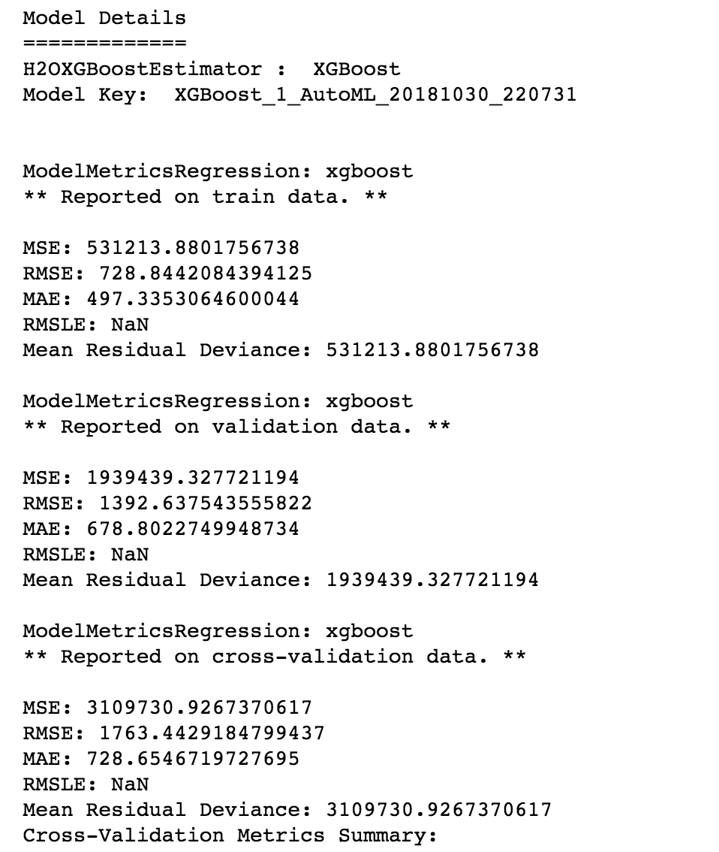
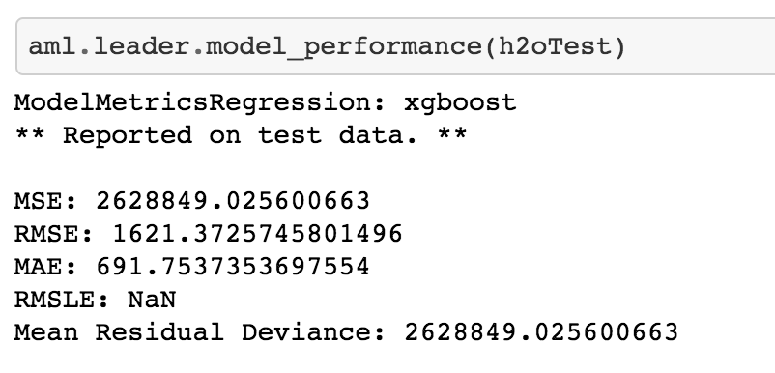
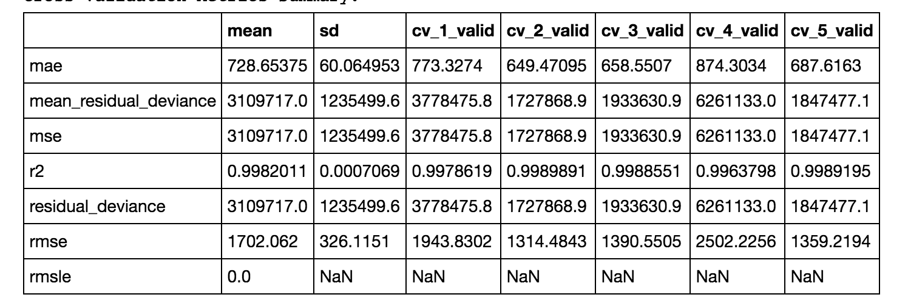
Output on training and testing
Notes:
The residual plot by this model is what we expected to see. Points scattered around centerline, the distribution of train and test are similar, the residual deviance is small.
H2O also gives us more detail about model. For example, it gives us MSE, rmse about train data, and cross validation data. We can also use it to predict. Then we will also get MSE, RMSE on our testing result.

Slide 16
Quick Demo and Code Walkthrough
https://github.com/XC-Li/LMI-Data-Synthesis-Competition
Notes:
So now I’m going to give you a demo on how to predict your data using XgBoost by H2O. We have shared everything like source code on github.

Slide 17
Thank you
Notes:
this is the end of presentation. Hope you enjoy it. Thank you

